Slide 1
Modeling complex systems

Slide 2
Goal
How to model complex systems
Introducing list processing via simlib
Examples

Slide 3
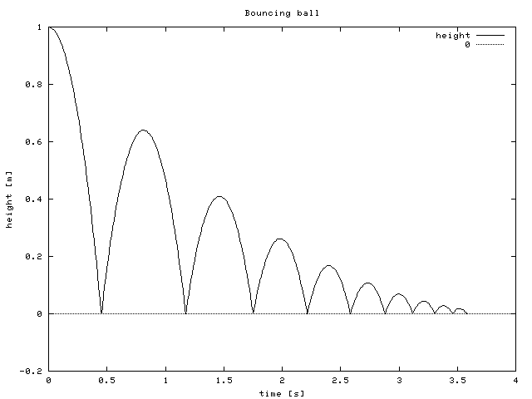
Bouncing ball -snapshot

Slide 4
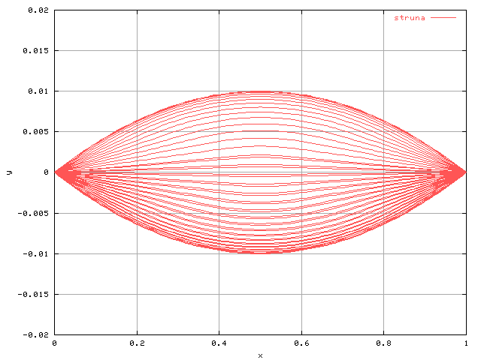
String vibration

Slide 5
Simple systems
No or one single list of records (event list), e.g Customers
Single attribute (e.g. arrival time)
FIFO processed
Complex systems
Multiple lists
Large # of records and attributes
Non-FIFO

Slide 6
storing lists of records
Sequential allocation
records in a list are put into physically adjacent storage locations, one record after another.
linked-allocation
each record in a list contains its usual attributes and pointers (or links) giving the logical relationship of the record to other records in the list.
Records in a list that follow each other logically need not be stored in physically adjacent locations.
Reduces processing time
No need to move each entry.
speed up event-list processing
Reduce amount of required memory.
Simultaneous storing and manipulation of lists.

Slide 7
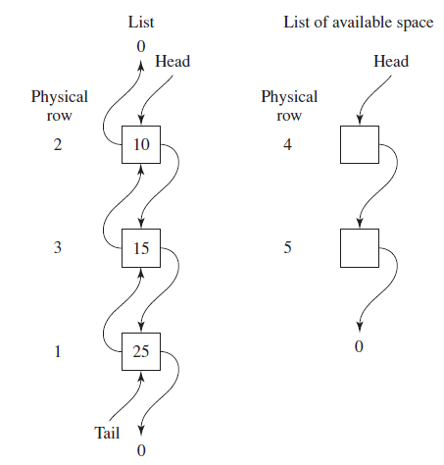
Example: Queuing simulation
list containing the customers waiting in queue to be served.
Each record in this list has the single attribute, “time of arrival.”
Suppose that at time 25 in the simulation there are three customers in queue,
times of arrival 10, 15, and 25, and that these records are stored in (physical) rows 2, 3, and 1 of an array with 5 rows and 1 column.
we assume that there will never be more than five customers (for e.g.)
Rows 4 and 5 are members of the LAS.
Note that the head pointer of the list is equal to 2,
the successor link for the record in row 2 is equal to 3, the predecessor link for the record in row 3 is equal
to 2, etc.
next event in the simulation (after time 25) is the arrival of a customer at time 40
we would like to add an appropriate record to the list, which
is to be processed in a FIFO manner.
Since the head pointer for the LAS is equal to 4,
the record for the arriving customer will be placed in physical row 4 of the array and
the head pointer of the LAS is now set to 5,

Slide 8
Since the new record will be added to the tail of the list and the tail pointer for the list is now equal to 1,
the successor link for the record in row 1 is set to 4,
the predecessor link for the new record, i.e.,
the one in (physical) row 4, is set to 1, the successor link for the new record is set to 0, and the tail pointer for the list is set to 4.

Slide 9
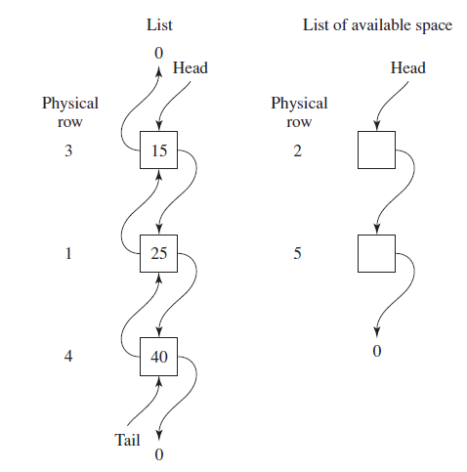
Thus, removing a record from the head of the list always requires setting only four links or pointers.
Contrast this with the brute-force approach of Chap. 1, which requires moving each record in the (sequential) list up by one location.

Slide 10
More complex systems
Discrete Dynamical Systems
State changes at discrete time intervals
Recurrence relations
Difference equations
➔Population models
Interacting simple models have emergent complex phenomena ➔ chaos

Slide 11
Linear Birth model
Let N(t) denote the density of some population at time t.
We want to construct a mathematical model able to predict the density of
the same population at time t + t, that is N(t + t).
Assume that:
all individuals are the same
there is enough food and space for every individual
each individual has λ children every σ time units
there is no death in the interval [t; t + Δt)
children do not start reproducing in the interval [t; t + Δt)

Slide 12
Exponential growth and phase portrait

Slide 13
Add More complexity
Death
N_{t+1} = r_{d}N_{t} – s_{d}N_{t}
= (r_{d} –s_{d})N_{t}
= α Nt
e.g. Rd =2, sd= 0.5,
α=1.5
Migration

